Slide 1
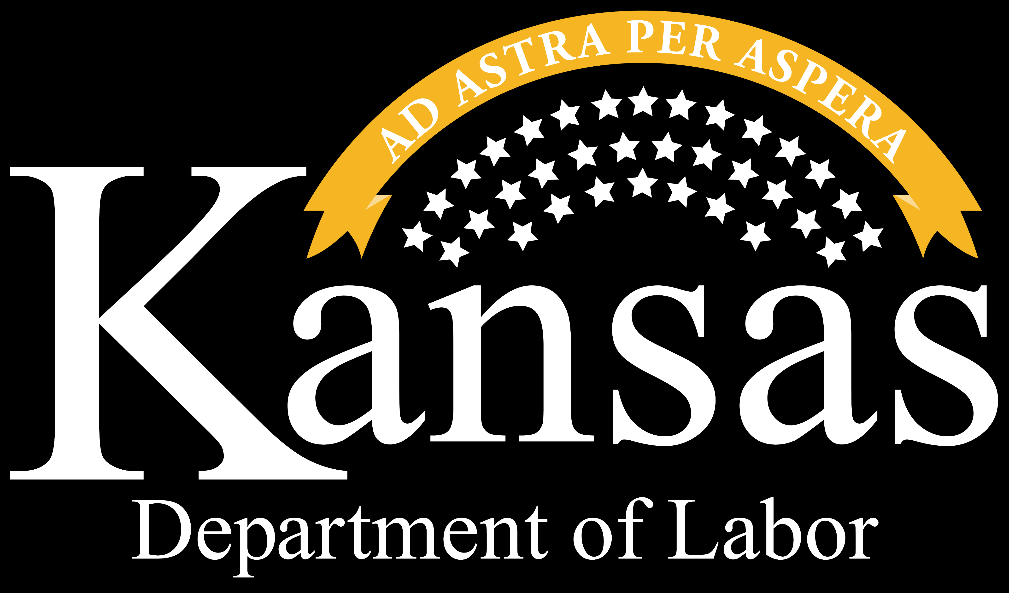
Practical AI Applications with Project Management
Jeffry Lewis, CIO/KDOL and
Tami Herron, PMO Manager/KDOL

Slide 2
Introduction
Last year I joined the Kansas Department of Labor as the PMO Manager. The goal was for us to create a Project Management Office within KDOL to implement standardized project management practices to ensuring timely and successful delivery of critical IT projects.
Our key responsibilities include:
Project planning and resource management
Managing stakeholder relationships and communication
Documenting processes and best practices
Leveraging AI through ChatGPT has helped us research and implement best practices, streamline processes, develop effective communication strategies and foster a new, collaborative way of working as a team.

Slide 3
Challenges
Our project management team encountered several key challenges:
Lack of transparency into PMO Processes
Lack of clarity about what qualifies as a project
Uncertainty about the role and responsibilities of Project Managers
Questions about the value of project management to business and IT stakeholders
Inconsistent language and terminology when describing Project Management activities
Challenges in managing and sharing project knowledge across the Agency
Lack of Business Requirements heading into a project
These challenges hindered our ability to focus on strategic project delivery and drive projects to successful completion.
SOLUTION: ChatGPT helped us define the role of the PMO in clear, consistent terms, allowing us to align with our KITO office and PMO best practices.

Slide 4
ChatGPT as a Best Practice Engine
AI helped us standardize using industry best practices;
By assisting in research to define best practices within multiple industries;
Ensuring that the PMO is aligned with up-to-date practices and trends;
Allowing us to adopt methodologies that have been proven and successfully implemented elsewhere, reducing the trial-and-error phase and providing a solid foundation for our PMO;
Provide instant access to project management guidelines, frameworks and other resources, driving towards consistency in proven processes.
AI also helped us streamline processes by;
Using prompts to answers questions related to processes, tools and best practice;
Consolidating multiple sources targeted at specific questions/processes, allowing for faster decision-making.
It learns!

Slide 5
Process “Engineering” by ChatGPT
By using AI to define best practices and processes, it has helped us set realistic expectations by;
Simplifying Communication: By defining project management concepts in simple, non-technical terminology, it makes it easier to communicate the role and benefits of project management to stakeholders;
Clarifying Roles: By providing clear role definition and examples of project management activities AI helps set clear expectations for both the PMO and other agency teams;
Improving Stakeholder Understanding: AI generated materials, like presentations and FAQs, help communicate the value of the PMO and its practices to business and IT stakeholders;
Foster Buy-In and Support: Structured, consistent processes identified in AI research bring clarity and transparency to our processes and help support our teams through change.

Slide 6
LLM: The Communications Master
And AI helped us define enhanced communication plans for collaboration with our teams by;
Developing templates for presentations, communication plans, status reports, training and testing plans;
Improving Stakeholder engagement strategies by analyzing past communications and offering insights into more effective messaging techniques;
Choosing AI tools that foster a collaborative environment by facilitating virtual brainstorming sessions, helping generating new ideas, and summarizing emails, chats, meeting notes, etc.;
And encouraging continuous improvement of process by analyzing feedback and suggestion enhancement to the process.

Slide 7
UI Modernization
Initial Challenges
The job search weekly certification process changed
Significantly more demanding on the claimant
Old system had between 1200 / 2000 calls, which provided a 13 question yes/no responses
New system requires actual data job search information;
Business names,
Application method, and
Additional job search efforts
Benefits
Takes pressure off of UI Contact Center
Gives an alternate method from the website
Ability to train for different workflows
Scalability

Slide 9
Conclusion
Summarize
Call to Action – Encourage exploration of AI tools for growth of the Agency
Q&A

Slide 10
Connect With Us
Website: dol.ks.gov
Twitter: @KansasDOL
Facebook: facebook.com/KansasDOL
LinkedIn: linkedin.com/company/KDOL
Instagram: ks_dol

